Slide 1
Water in Africa: Technical and Equipment Researchers, LTD.
(WATER)
Water Point Repair in Tanzania

Slide 2

Goal:
Reduce overhead costs by anticipating water pump maintenance status
Notes:
-Consequent to our goals, we are not trying to necessarily identify the highest-need areas. - Enable efficient operations: market research

Slide 3
Executive Summary
Current Landscape
The Problem
Data Understanding
Data Limitations
Predictive Analysis
Our Model
Feature Importance
Model Performance
Conclusion
Improvement Areas
Growth Opportunities
Takeaways

Slide 4
The Problem
Waterpoint needs work
Maintenance services are costly and rare
Waterpoints break and stay broken
Notes:
Access to reliable water isn’t just hampered by the ability to get a well-- many organizations will offer to build them-- but in actually keeping one running when you get it. One of the choke points there is that it’s often very expensive to get parts & work done, and parts especially are often only found in far-off urban lococations.

Slide 5
The Problem
The Solution
Waterpoint needs work
Maintenance services are costly and rare
Waterpoints break and stay broken
Enable more efficient market planning
Reduce volatility & increase profitability for maintenance providers
Increase number & spread of maintenance providers

Slide 6
Current Landscape
Notes:
EDA Vis:
Heatmap: functional/functional needs repair/nonfunctional

Slide 7
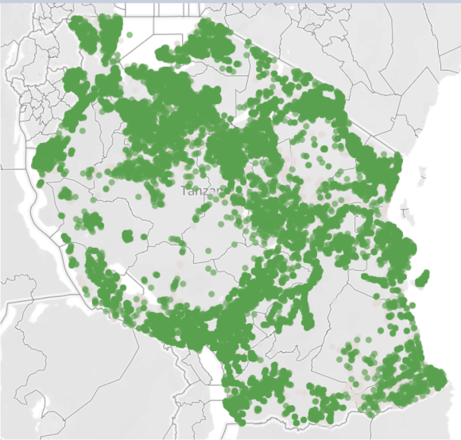
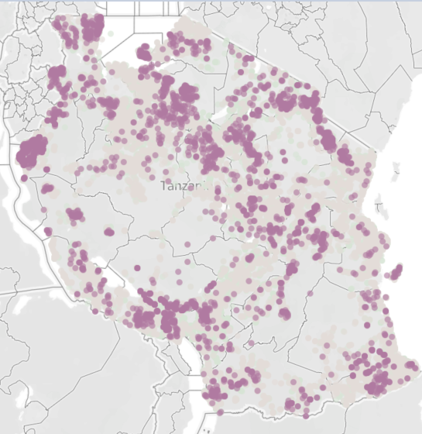
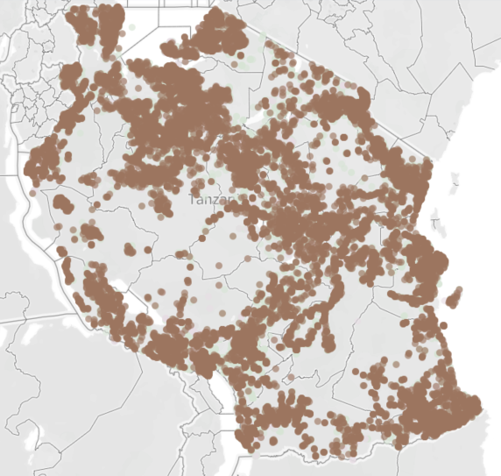
Data Understanding:
Geographical
Functional
Needs Repair
Non-Functional
Notes:
“Just to give an idea of the distribution & scale”
There’s a lot of water points in our data set, and they’re all distributed superficiallly in the same way-- where people are

Slide 8
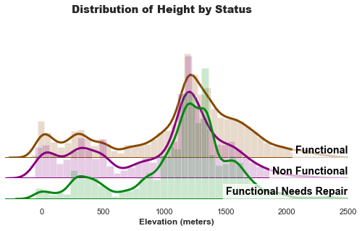
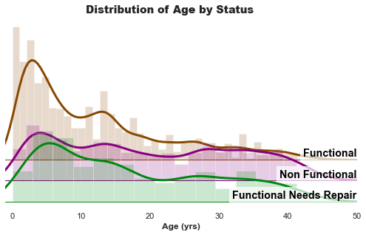
Data Understanding
Obtained from Taarifa and Tanzanian Water Ministry
59,400 entries
38 properties per entry
Properties cover:
Geography
Geology
Community Engagement
Operational habits
Age
Resource availability
Waterpoint specifics
Notes:
GRAPHS: Many of these features are not obviously separated by status there’s no obvious single predictor
59400 entries recorded, 38 properties
Geographical / Location: Hierarchical (Basin, Region, District)
Status Group: Functional, nf, nr
Water point construction:
Water specific:
Management:
Kind of pump, when installed, how managed (prediction input guidelines from taarifa/datadriven.org)

Slide 9
Data Limitations
Data Correction Strategies:
Multiple reporters
Autocorrection used to offset typographical errors
Inconsistent naming/reporting
Missing elevations filled using google maps data
Opaque values
Few examples of “Needs Repair”
Other missing data filled by comparison
Clear mistakes
Notes:
Clear mistakes: Some wells are recorded as being built at a time after they were recorded

Slide 10
Predictive Analysis

Slide 11
Our Model
Model looks at:
Region & Elevation
Water Quantity, Quality, and Source
Payment Strategy, Community Engagement, and Management
Well & Pump types & Capacity
Age
Implements “Random Forest Classification”
Optimized to reduce over-extending expectations
Notes:
-The model looks at a combination of features that were found to work well and which should be readily available for pumps not in dataset. Crucially, some features do overlap here in nature (e.g, what kind of well you have *should* be related to what kind of water you have)
Scoring done off recall for two of the three cases (weighted) ['elevation', 'amount_tsh', 'public_meeting', 'time_interval', 'water_quality_character', 'region', 'scheme_management', 'extraction_type_group', 'management', 'payment_type', 'water_quality', 'quantity', 'source', 'waterpoint_type_group']

Slide 12
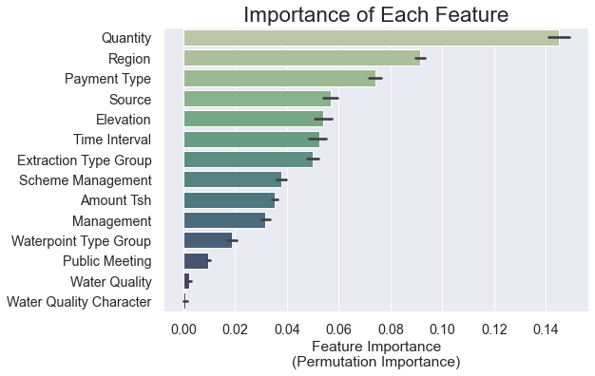
Importance of Features
Empirical approximation of feature importances
Most Important:
Availability
Location
Payment Strategy
Quality features may not be as unimportant as they appear
Notes:
“WITHOUT GETTING INTO TECHNICAL DETAILS”, method by which these are calculated can undervalue groups of colinear features

Slide 13
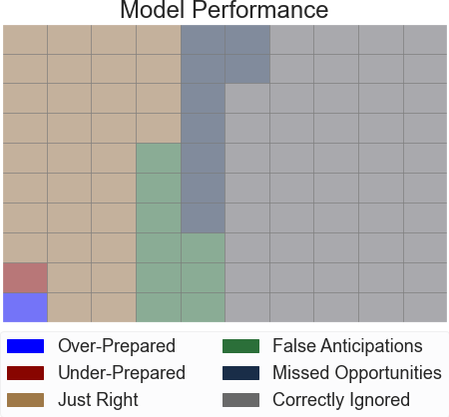
Model Performance
Notes:
-Model accuracy compared to baseline
-ML value-added
Given a hundred hypothetical wells being classified...

Slide 14
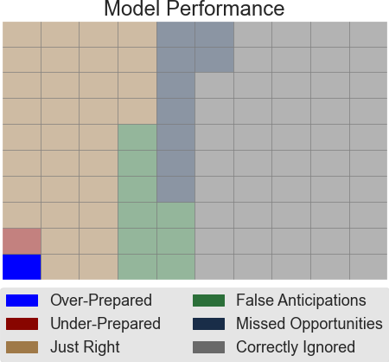
Model Performance
Notes:
-Model accuracy compared to baseline
-ML value-added
1
“Over-prepared”: Predicted non-functioning, actually needs repair

Slide 15
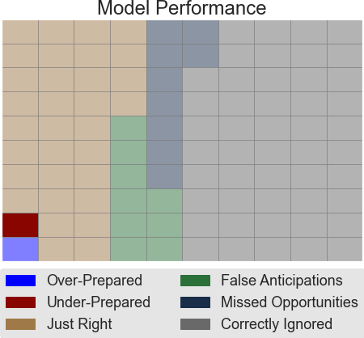
Model Performance
Notes:
-Model accuracy compared to baseline
-ML value-added
1
“Under-prepared”: predicted needs repaired, actually non-functioning

Slide 16
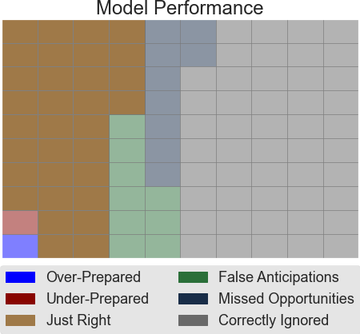
Model Performance
Notes:
32
“Just Right”- predicted non-func or rep, were correct

Slide 17
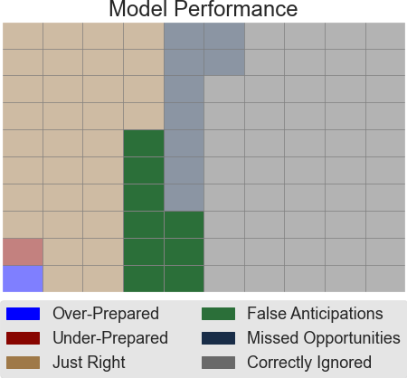
Model Performance
Notes:
-Model accuracy compared to baseline
-ML value-added
9 “False Anticipation” - predicted non-fun or rep, were incorrect

Slide 18
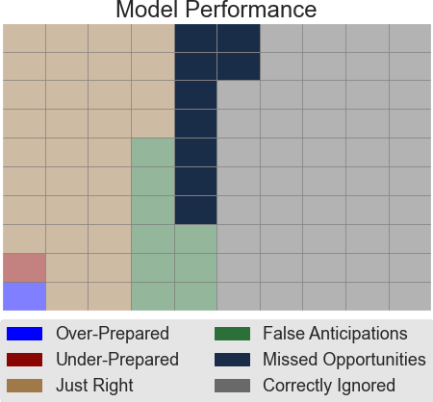
Model Performance
Notes:
9
“Missed” - predicted func, were incorrect

Slide 19
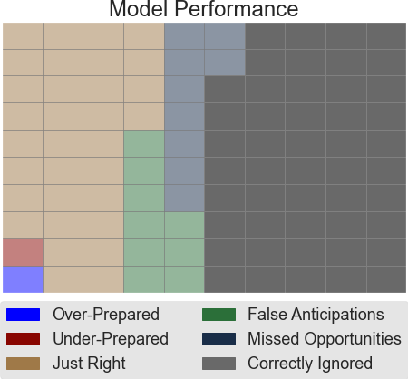
Model Performance
Notes:
48
“Correctly ignored” predicted func, were correct

Slide 20
Conclusion & Takeaways

Slide 21

Areas to Improve
Better computational resources
Underlying data quality correlations
Obtain more data for integrity control
More sophisticated data correction
Further feature optimization
Informed feature engineering
Notes:
KNN models seemed kind of promising, but couldn’t be ran full-blooded on local machines
Unable to OHE everything
With more time slices we could start to figure out how long pumps are likely to last
Iterative design hampered/prevented by computational resources
Probable underlying correlations in data quality
Obtain more data for integrity control
More sophisticated data correction
Further feature optimization
Informed feature engineering

Slide 22
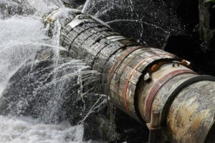
Growth Opportunities
Cautiously investigate applicability to other areas
Develop lifetime estimations
Invert model to identify demand for particulars
Combine with economic models

Slide 23

Takeaways
Improve maintenance planning & budgeting by:
Using readily available categories of data
Applying data to our model
Model gives desired performance:
91% for pumps needing any maintenance
78% for identifying level of maintenance
Goal: Reduce overhead costs by anticipating water pump maintenance status
Notes:
Applying our model on data, obtainable as it comes in will aid a productive/profitable/efficient implementation of a repair/replace service
Planning & Budgeting for repair services can be improved with predictive profiling of known waterpoints
We created a model to do these predictions
Model will give desired performance:
91% of the time when identifying pumps needing any maintenance
78% of the time when identifying level of maintenance required
Model relies on readily available data that can be supplied for future waterpoints

Slide 24




“ASANTE!”
James Shaw
Alexander Newton

Slide 25

Questions?

